Slide 1
PLANE AND SPHERICAL TRIGONOMETRY
Trigonometric Ratios, Solutions to Right Triangles (Angles of Elevation, Depression, Bearing and Course)
10/6/2010
Engr. Mark Edison M. Victuelles

Slide 2
SPECIFIC OBJECTIVES:
At the end of the lesson, the student is expected to :
Define the six trigonometric functions.
Identify the relations derived from Pythagorean Theorem.
Find the values of the six trigonometric functions of special angles.
Define the trigonometric functions of complementary angles
Solve right triangles given the measures of one angle and one side or the measures of two sides.
Define angles of elevation and depression.
Define course and bearing.
Solve application problems on right triangles
10/6/2010
Engr. Mark Edison M. Victuelles

Slide 3
Triangles
Triangles are polygon having three sides and three angles.
Kinds of Triangles
Kinds of triangle according to the measure of its angle:
Right Triangle – triangle with a right angle
Oblique triangle – triangle with no right angle.
  Acute triangle – triangle having three acute angles
  Obtuse triangle – triangle with an obtuse angle.
Kinds of triangle according to the measure of its sides:
Scalene triangle – triangle with no equal sides
Isosceles triangle – triangle with two equal sides
Equilateral triangle – triangle with all three sides equal
10/6/2010
Engr. Mark Edison M. Victuelles

Slide 4
The Trigonometric Functions
The trigonometric functions are sine (sin), cosine (cos), tangent (tan), cotangent (cot), secant (sec) and cosecant (csc).
Consider the right triangle ABC, with right angle at C
B
c
a
C
A
b
10/6/2010
Engr. Mark Edison M. Victuelles

Slide 5
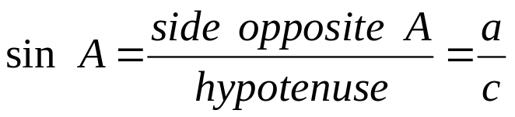
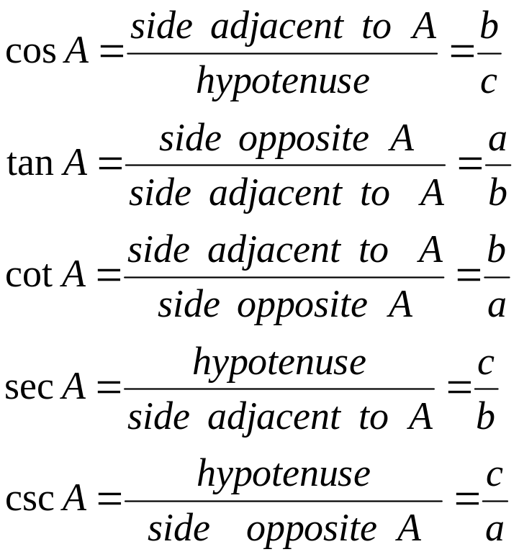
Trigonometric Ratios
10/6/2010
Engr. Mark Edison M. Victuelles

Slide 6

Example
Draw the right triangle whose sides have the following values, and find the six trigonometric functions of the acute angle A
a = 5 , b = 12, c = 13
a = 12 , b = 9, c = 15
a = 6 , b = 8 , c = 10
a = 1 , b = , c = 2
10/6/2010
Engr. Mark Edison M. Victuelles

Slide 7

The Pythagorean Theorem
The Pythagorean theorem states that the square of the hypotenuse is equal to the sum of the squares of the other two sides.
B
c
a
C
A
b
10/6/2010
Engr. Mark Edison M. Victuelles

Slide 8




Example:
Each of the following is a point on the terminal side of an angle in standard position. Determine the value to four decimal places of all six trigonometric functions of the angle.
10/6/2010
Engr. Mark Edison M. Victuelles

Slide 9
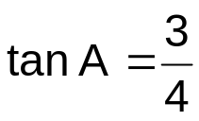

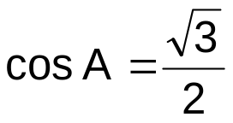
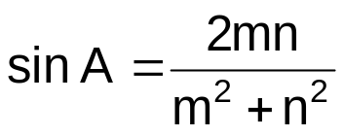
Example:
Find the other five functions of the acute angle A, given that:
10/6/2010
Engr. Mark Edison M. Victuelles

Slide 10
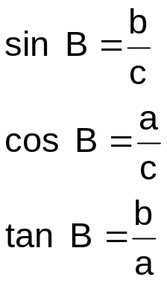
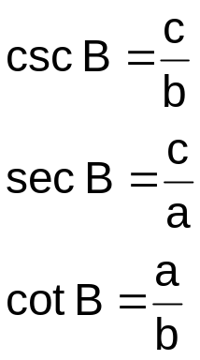
Functions of Complementary Angles
By referring to the definitions of the trigonometric functions, for the acute angle B,
B
c
a
C
A
b
10/6/2010
Engr. Mark Edison M. Victuelles

Slide 11
Functions of Complementary Angles
sin B = sin (90° - A ) = cos A
cos B = cos(90° - A ) = sin A
tan B = tan (90°- A ) = cot A
cot B = cot (90° - A ) = tan A
sec B = sec (90° - A ) = csc A
csc B = csc (90° - A ) = sec A
10/6/2010
Engr. Mark Edison M. Victuelles

Slide 12


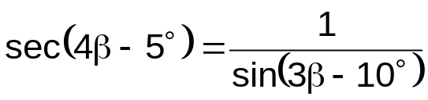
Example:
Express each of the following in terms of its cofunction:
a. sin 76°
b. csc 80°35’32”
c. cos 39°23’
d. tan ( A + 15°)
Determine the value of that will satisfy the following:
a.
b.
c.
10/6/2010
Engr. Mark Edison M. Victuelles

Slide 13

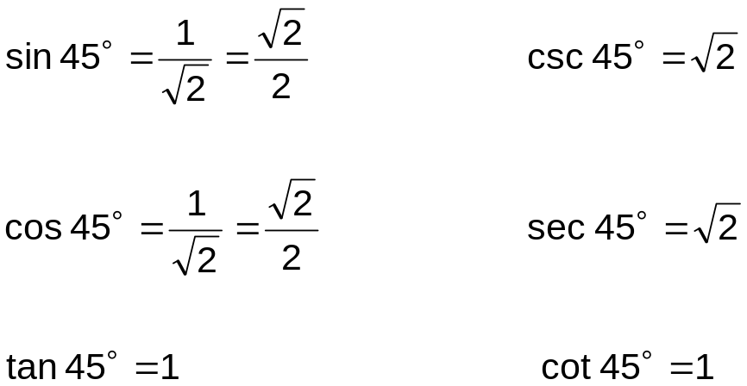
Trigonometric Functions of Special Angles
B
a = 1
45°
A
C
b = 1
10/6/2010
Engr. Mark Edison M. Victuelles

Slide 14

Trigonometric Functions of Special Angles
B
30°
c = 2
a =
60°
A
b = 1
C
10/6/2010
Engr. Mark Edison M. Victuelles

Slide 15
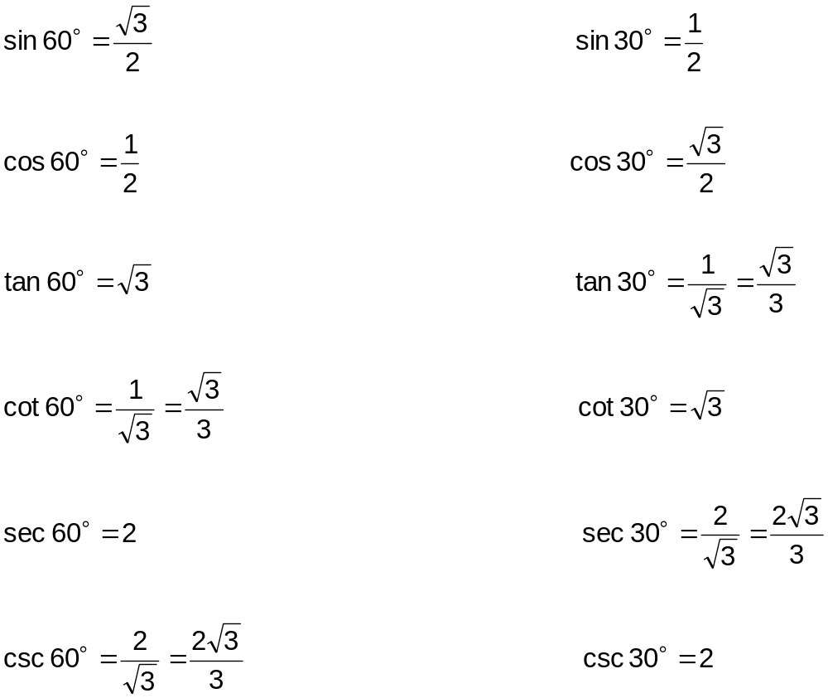
Trigonometric Functions of Special Angles
10/6/2010
Engr. Mark Edison M. Victuelles

Slide 16
Example:
Without the aid of the calculator, evaluate the following
a. 3 tan² 60° + 2 sin² 30° - cos² 45°
b. 5 cot² 45° + 5 tan 45° + sin 30°
c. cos² 60° - csc² 30° - sec 30°
d. tan 60° + 2 cot 30° - sin 60°
e. tan⁵ 45 + cot² 45° - sin⁴ 60°
10/6/2010
Engr. Mark Edison M. Victuelles

Slide 17
Example:
Solve the following triangles, in which C = 90°:
a. a = 35 , c = 92
b. A = 29°30’ , b = 72.8
c. B = 17°24’ , b = 45.5
  d. a = 19 cm , B = 42°
e. a = 30 ft., b = 19 ft
10/6/2010
Engr. Mark Edison M. Victuelles

Slide 18
Angles of Elevation and Depression
If an observer sights an object, the angle formed between a horizontal line and his line of sight is called the angle of elevation if the line of sight is above the horizontal and the angle of depression if the line of sight is below the horizontal
B (Object)
θ angle of elevation
A
Horizontal Line
Horizontal Line
A
θ angle of depression
B (Object)
10/6/2010
Engr. Mark Edison M. Victuelles

Slide 19

Examples
If the angle of elevation of the top of the tower is 52°31’. Find the height of the tower if the observer is 41.5 m from its base.
H
52°31’
41.5
54.12 m
10/6/2010
Engr. Mark Edison M. Victuelles

Slide 20
Examples
Find the angle of elevation of the sun if the shadow of the pole 60 ft tall reaches 92 ft from the pole.
60 ft
θ
92 ft.
33°06’41”
10/6/2010
Engr. Mark Edison M. Victuelles

Slide 21


Examples
From the top of a lighthouse 30 m high, the angle of depression of a boat in the sea was 28°45’. How far was the boat from the top and base of lighthouse?
28°45’
30m
28°45’
54.68 m and 62.37 m
10/6/2010
Engr. Mark Edison M. Victuelles

Slide 22

Examples
From a window Carlo observes the lamp post. He noted that the angle of elevation of its top is 43°20’ while the angle of depression of its base is 20°15’. If the top of the lamp post is 30 m away from the window and its base is 25 m, what is the height of the lamp post?
30m
43° 20’
A
20°15’
25m
29.24 m
10/6/2010
Engr. Mark Edison M. Victuelles

Slide 23


Examples
From where he stands 75 ft. away from the tree, a mountaineer 6 ft. tall, found that the angle of elevation of the top of the tree was 37°25’. Find the total height of the tree?
37° 25’
6 ft.
75 ft.
10/6/2010
Engr. Mark Edison M. Victuelles

Slide 24
Bearing
Bearing of the point is the clockwise angle from north to the line of sight to appoint of reference.
Course
In air or sea navigation, the angle measured clockwise from north to the line of travel is the course of the plane or the ship.
N
N
N
75°
150°
315°
S
S
S
10/6/2010
Engr. Mark Edison M. Victuelles

Slide 25
Examples
Towers A and B are on east-west line 125 m apart. Jojo, on the north of that line finds that the direction of towers A and B are N39°27’E and N50°33 W , respectively. How far is Jojo from each tower?
39°27’
50°33’
θ 50°33’ 39° 27’β
Tower A 125 Tower B
79.43 m and 96.52 m
10/6/2010
Engr. Mark Edison M. Victuelles

Slide 26
Examples
From port Ilocandia to Camp Airstrip a plane flies on a course of 285°. If Camp Airstrip is 1525 km further north than Port Ilocandia, find the distance from Port Ilocandia to Camp Airstrip
A
P
285°
10/6/2010
Engr. Mark Edison M. Victuelles

